Slide 1
Take Home Project for Enterprise Business Analytics Module
By
SSEMWEZI BENJAMIN
REG No: 2023-M132-21506

Slide 2
World Social-Economics Indicators
This dataset represents a comprehensive collection of key socio-economic indicators from countries worldwide. The data spans multiple years(from 1991 to 2014) and includes metrics that can help analyze the economic, health, and social conditions of each country. The indicators can be used to understand regional disparities, economic development, public health, and infrastructure status.

Slide 3
Project Objectives
Compare key indicators across different regions and income groups to identify disparities and common trends.
Examine birth and death rates across different regions and countries to understand demographic shifts and population dynamics.
Analyze population density data to explore its relationship with other economic and social indicators.
Investigate trends in infant mortality rates and life expectancy at birth to assess public health improvements or challenges.
Analyze unemployment rates across regions and countries to understand labor market conditions and trends.
Analyze the relationship between electric power consumption and economic indicators such as GDP and GDP per capita.
Perform year-over-year comparisons to highlight significant changes in the dataset.
Provide recommendations for policy improvements based on data-driven insights.

Slide 4
World Social-Economics Indicators Dataset
The dataset contains socio-economic indicators collected from 135 countries across the world from 1991 to 2008. It includes the following columns:
Country Name: The name of the country.
Country Code: The ISO code of the country.
Region: The region in which the country is located (e.g., Europe & Central Asia, Sub-Saharan Africa, Latin America and the Carrabean, Middle East and North Africa, East Asia and the Pacific, South Asia and North America).
IncomeGroup: The income classification of the country (e.g., High income: OECD, High Income(nonOECD),Upper middle income, Low income and lower middle income).
Year: The year the data was collected. It includes years from 1991 to 2014.
Birth rate, crude (per 1,000 people): The number of live births per 1,000 people in the population.
Death rate, crude (per 1,000 people): The number of deaths per 1,000 people in the population.
Electric power consumption (kWh per capita): The average kilowatt-hour (kWh) of electric power consumed per person.
GDP (USD): The Gross Domestic Product in U.S. dollars.
GDP per capita (USD): The GDP divided by the population, indicating the average economic output per person.
Individuals using the Internet (% of population): The percentage of the population that uses the internet.
Infant mortality rate (per 1,000 live births): The number of infants dying before reaching one year of age, per 1,000 live births in a given year.
Life expectancy at birth (years): The average number of years a newborn is expected to live, assuming mortality patterns at the time of birth remain constant.
Population density (people per sq. km of land area): The number of people living per square kilometer of land area.
Unemployment (% of total labor force): The percentage of the total labor force that is unemployed but actively seeking employment and willing to work.

Slide 5
Data collection methods
Government Statistics: Collected from national statistics offices and databases.
International Organizations: Compiled by international organizations such as the International Labour Organization (ILO), United Nations (UN), and World Health Organization (WHO).
Surveys and Censuses: Data obtained through national surveys and population censuses.
Estimates and Projections: Calculated using statistical models and estimation techniques when direct data collection is not feasible.

Slide 6
Relevance to Business Analytics
This dataset is relevant to business analytics for several reasons:
Economic Analysis: Assessing GDP and GDP per capita to understand economic performance.
Health Studies: Analyzing infant mortality rate, life expectancy, and crude birth/death rates to gauge public health.
Infrastructure Planning: Using electric power consumption and internet usage data to plan and develop infrastructure projects.
Social Programs: Identifying regions with high unemployment rates to target job creation programs.
Demographic Studies: Studying population density and birth rates for urban planning and resource allocation.

Slide 7
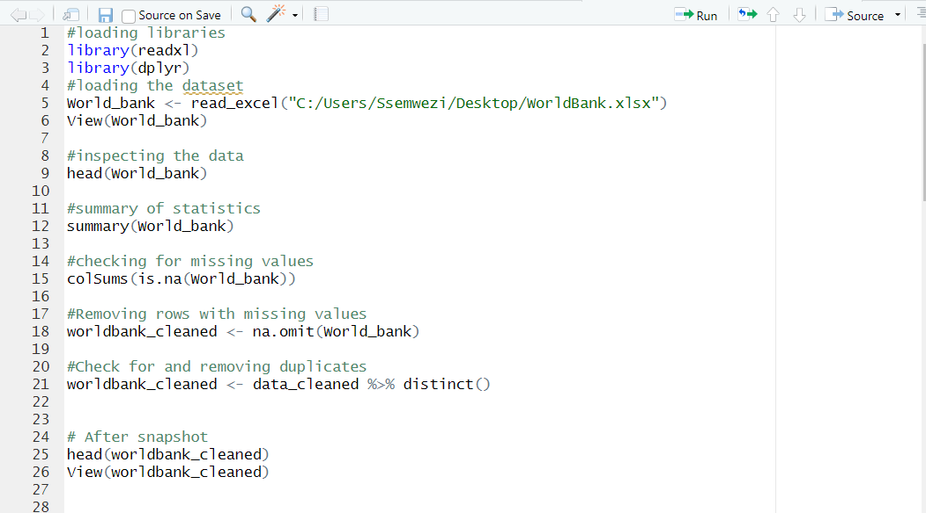
Data Cleaning Using R
It included removing missing values and duplicates, correcting errors, and standardizing data formats. Below are the steps taken in R

Slide 8
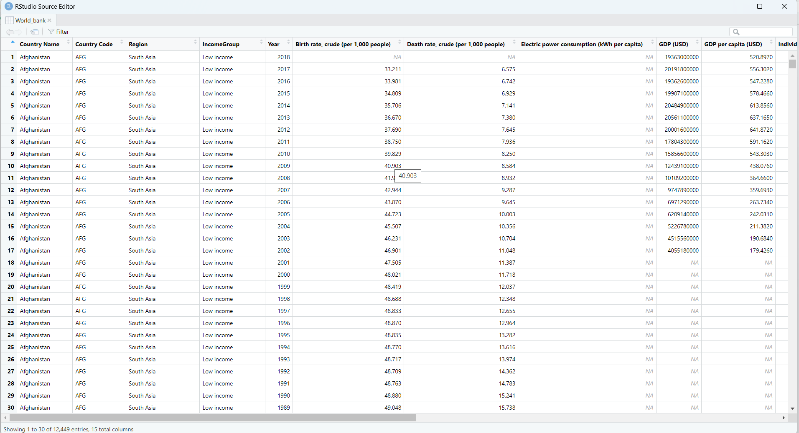
Dataset before cleaning

Slide 9
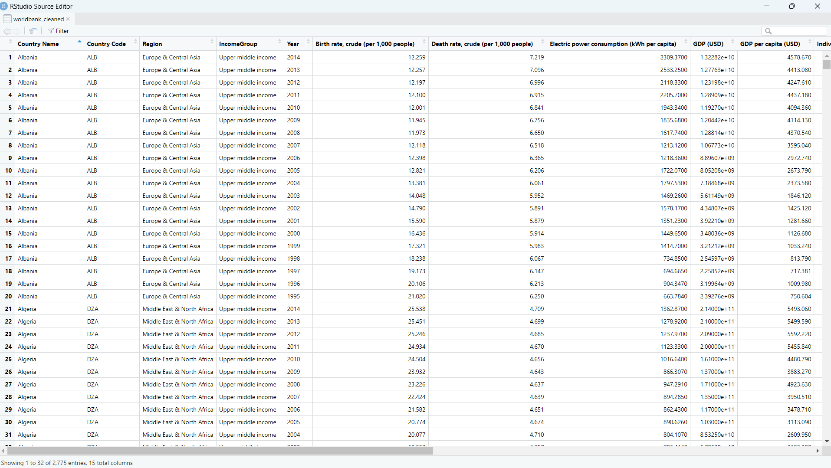
Dataset after Cleaning

Slide 10
Data Intergration
Rationale for Integration
Integrating additional socio-economic indicators such as education and healthcare expenditure with the original dataset provides a more comprehensive
view of a country's socio-economic status. This integration allows for deeper analysis and insights into how various factors like education and healthcare
influence economic indicators such as GDP, unemployment, and life expectancy.
Process of Data Integration
Data Preparation: Created a smaller dataset with relevant additional indicators.
Loading Datasets: Loaded both the original and smaller datasets into R.
Merging Datasets: Merged the datasets using common keys (Country Name and Year).
Challenges Faced
Data Alignment: Ensuring that the keys used for merging (country names and years) are consistent across both datasets.
Handling Missing Values: The smaller dataset might not have data for all countries and years present in the original dataset, resulting in missing values after the merge.
Data Consistency: Ensuring that the data formats and types are consistent across datasets to avoid integration issues.

Slide 11
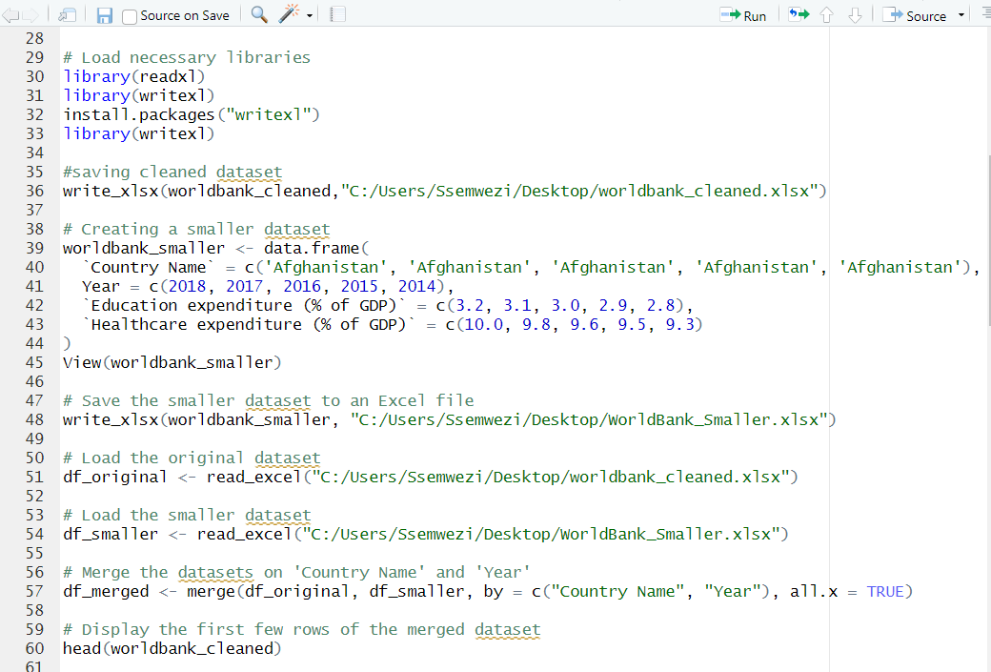
Data intergration in R

Slide 12
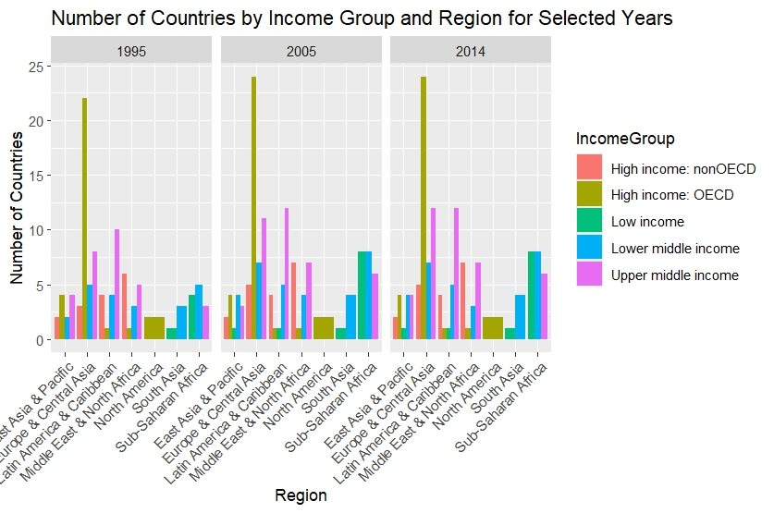
Summary of statistics and data visualization
Barplot representing number of countries by income group and region

Slide 13
General Observations
Income Group Distribution Over Time:
Across all regions, there is a noticeable trend of countries transitioning from low income to lower middle income and from lower middle income to upper middle income over the years.
High income (OECD and nonOECD) countries remain relatively stable, indicating that countries in these groups have maintained their economic status.
Regional Economic Development:
East Asia & Pacific and Europe & Central Asia show significant economic development, with an increasing number of countries moving to higher income groups over the years.
Sub-Saharan Africa remains predominantly low income, although there is a slight increase in lower middle income countries, indicating gradual economic development.
South Asia shows a similar trend of economic improvement, with a shift from low income to lower middle income.
Stability in High-Income Regions:
Regions like North America and parts of Europe & Central Asia show stability in their high-income status, reflecting sustained economic prosperity.

Slide 14
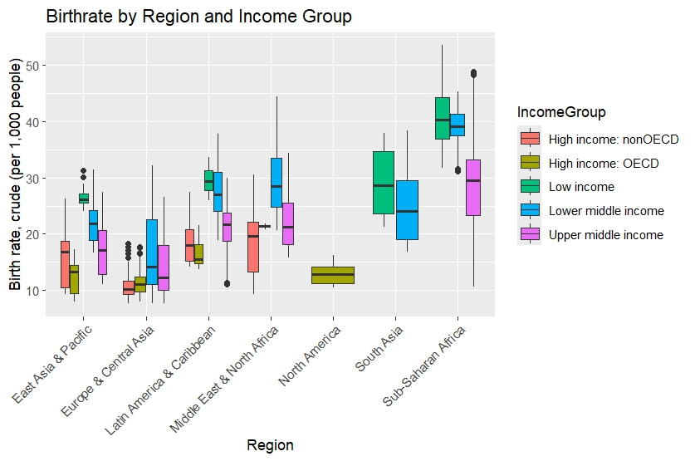
Boxplot showing Birth rate by Region and Income group

Slide 15
General Observations
Income Groups:
High income groups (both nonOECD and OECD) consistently show lower birth rates across all regions, reflecting lower fertility rates typical of more developed economies.
Low income groups have the highest birth rates, especially in regions like Sub-Saharan Africa and South Asia.
As income increases from low to lower middle and upper middle, birth rates tend to decrease, reflecting the demographic transition theory.
Regional Differences:
Sub-Saharan Africa and South Asia show the highest birth rates, particularly in low and lower middle income groups.
Regions like North America and parts of Europe & Central Asia show lower birth rates across all income groups, consistent with trends in more developed regions.
Middle East & North Africa, and Latin America & Caribbean show significant variability in birth rates across different income groups, indicating diverse demographic patterns within these regions

Slide 16
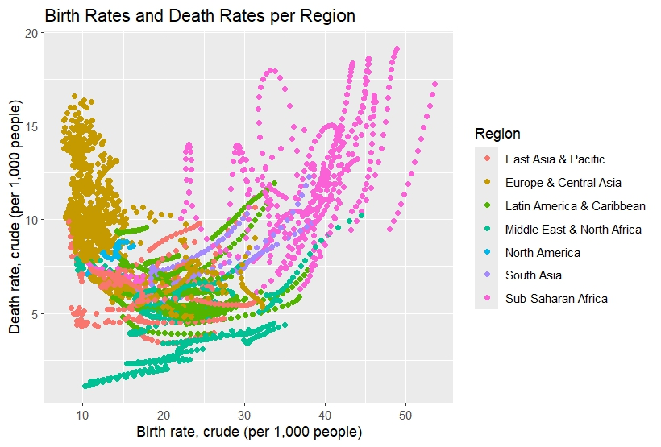
Birth Rates and Death Rates per Region:
Interpretation:
The scatter plot indicates that regions with higher birth rates also tend to have higher death rates.
Sub-Saharan Africa, for instance, shows high birth and death rates.
High birth and death rates in certainregions point towards potential issues in healthcare, nutrition, and general living conditions that need to be addressed.

Slide 17
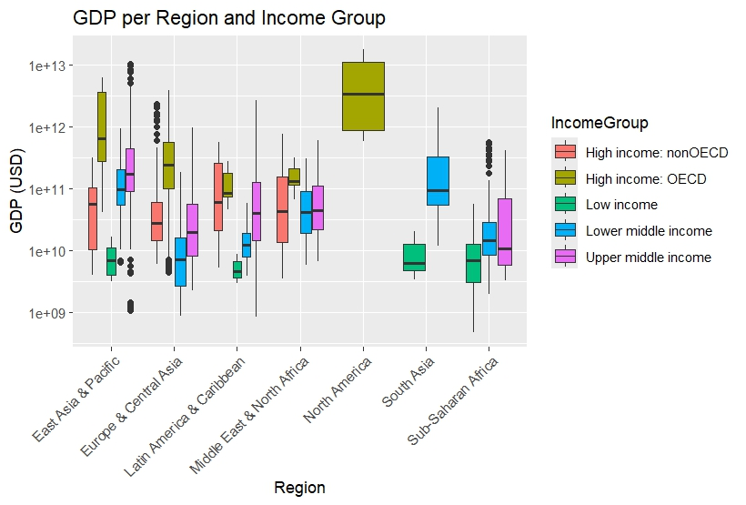
GDP per Region and Income Group
The box plots show a wide range in GDP across different regions and income groups, with higher GDP in high-income regions and lower
GDP in low-income regions. Economic disparity is evident across regions and income groups, indicating the need for economic policies aimed at promoting growth in lower-income regions.

Slide 18
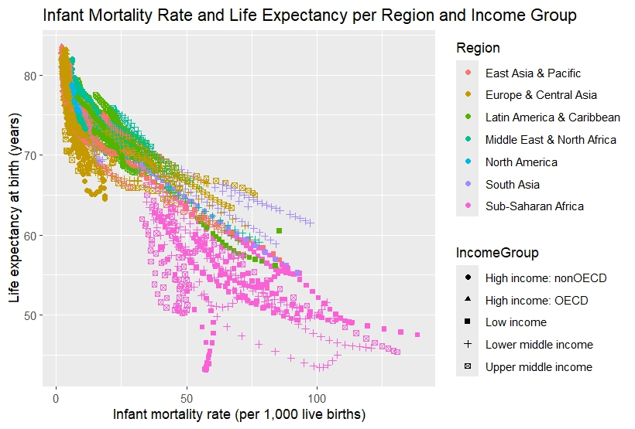
.
The scatter plot illustrates that regions with higher infant mortality rates generally have lower life expectancies. Sub-Saharan Africa has high infant mortality and low life expectancy, while high-income regions show the opposite trend. Conclusion: Improving infant mortality rates can significantly impact life expectancy, suggesting that healthcare improvements for infants and mothers are crucial for overall population health

Slide 19
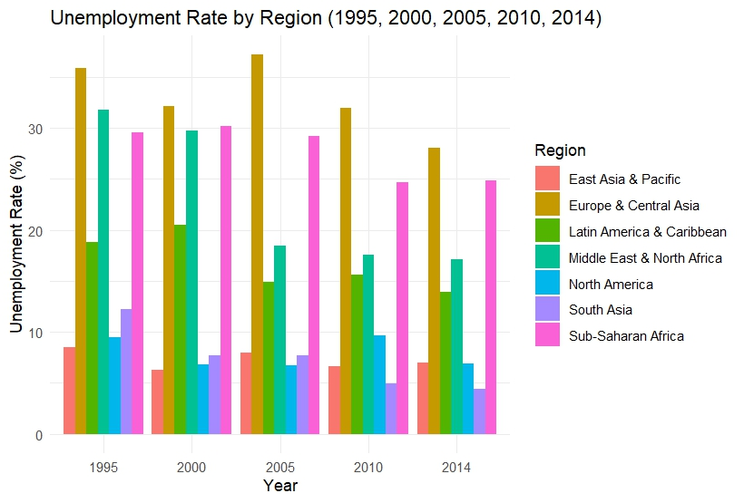
Unemployment Rate per Region per Year:

Slide 20
Analysis and Insights
Economic Stability and Development:
Regions like East Asia & Pacific and North America show relatively low unemployment rates, indicating stable economic conditions and effective labor market policies.
In contrast, Sub-Saharan Africa has consistently high unemployment rates, highlighting persistent economic challenges and possibly high youth unemployment.
Impact of Global Events:
The spike in unemployment in North America around 2010 can be linked to the aftermath of the global financial crisis.
Similar trends in Europe & Central Asia and Latin America & Caribbean suggest these regions were also affected by global economic downturns.
Regional Specific Challenges:
The Middle East & North Africa region shows significant variability in unemployment rates, which may be attributed to political instability, economic transitions, or social unrest during certain periods.
Trends Over Time:
Some regions like South Asia and East Asia & Pacific have shown resilience with relatively stable unemployment rates, while others like Sub-Saharan Africa continue to struggle with high unemployment.

Slide 21
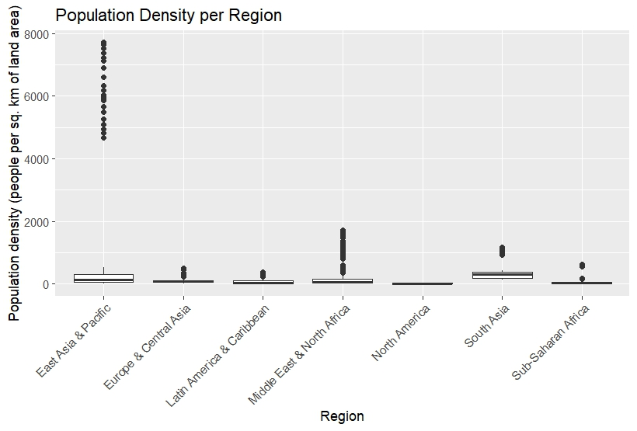
Population Density per Region
Interpretation: The box plots highlight the variation in population density across regions, with regions like East Asia & Pacific showing higher population densities compared to others.
Conclusion: Population density impacts infrastructure, resources, and urban planning. High-density regions may face more pressure on resources and services.

Slide 22
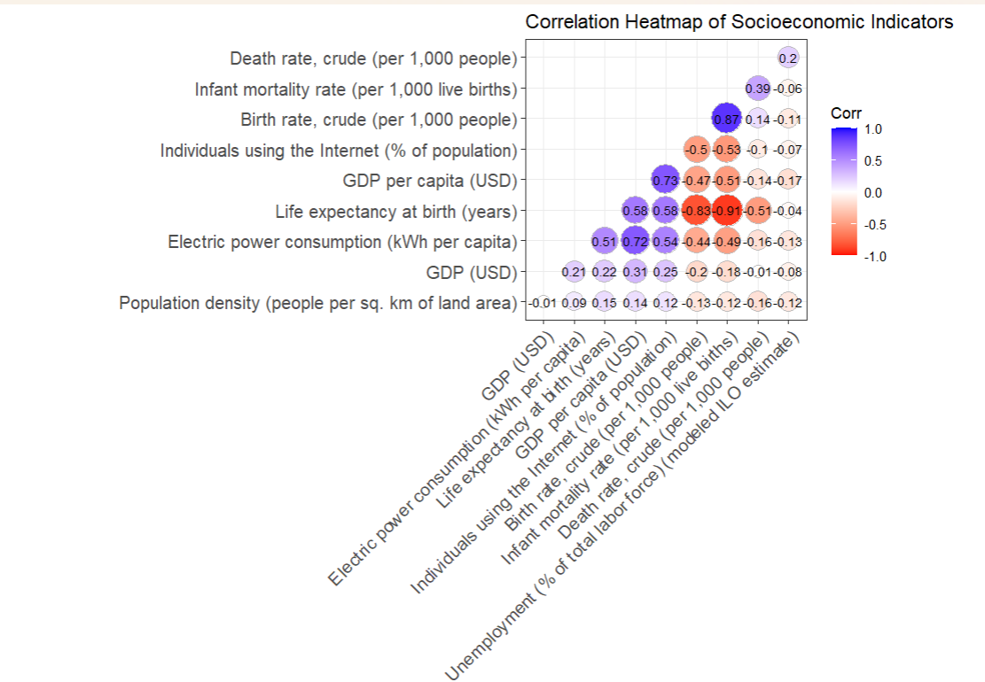
Correlation Heatmap
It provides a clear visualization of how socioeconomic indicators are interrelated.
Strong positive correlations suggest areas where improvement in one indicator is likely to coincide with improvements in another.
Negative correlations highlight potential areas of concern where increases in one indicator could lead to decreases in another.

Slide 23
Key Observations
High Positive Correlations:
GDP per capita (USD) and Life expectancy at birth (years): Strong positive correlation (0.83), suggesting that higher GDP per capita is associated with higher life expectancy.
GDP per capita (USD) and Individuals using the Internet (% of population): Strong positive correlation (0.87), indicating that wealthier countries tend to have higher internet usage rates.
Life expectancy at birth (years) and Individuals using the Internet (% of population): Positive correlation (0.73), implying that increased internet usage is associated with longer life expectancy.
Moderate Positive Correlations:
GDP per capita (USD) and Electric power consumption (kWh per capita): Positive correlation (0.72), suggesting that higher GDP per capita is linked with greater electric power consumption.
Life expectancy at birth (years) and GDP (USD): Moderate correlation (0.58), indicating that countries with higher GDP tend to have longer life expectancy.
Negative Correlations:
Infant mortality rate (per 1,000 live births) and Life expectancy at birth (years): Negative correlation (-0.75), showing that higher infant mortality rates are associated with lower life expectancy.
Death rate, crude (per 1,000 people) and Life expectancy at birth (years): Moderate negative correlation (-0.51), suggesting that higher death rates are linked with lower life expectancy.
Unemployment (% of total labor force) and Individuals using the Internet (% of population): Weak negative correlation (-0.14), indicating that higher unemployment rates are slightly associated with lower internet usage.
.

Slide 24
Additional Insights
Population density (people per sq. km of land area):
Has a weak negative correlation with GDP per capita (-0.10) and life expectancy (-0.12), suggesting that more densely populated countries might have slightly lower GDP per capita and life expectancy.
Electric power consumption and Individuals using the Internet: Moderate positive correlation (0.58), indicating that higher electricity consumption is associated with increased internet usage.
Socioeconomic Implications
Economic Development: Countries with higher GDP per capita tend to have better socio-economic indicators such as higher internet usage, longer life expectancy, and lower infant mortality rates.
Healthcare and Infrastructure: Improved healthcare (evidenced by lower infant mortality rates and longer life expectancy) is associated with higher GDP per capita and better access to technology (internet usage).
Energy Consumption: Economic prosperity (GDP per capita) is closely linked to higher energy consumption, which can be indicative of industrial and technological development.

Slide 25
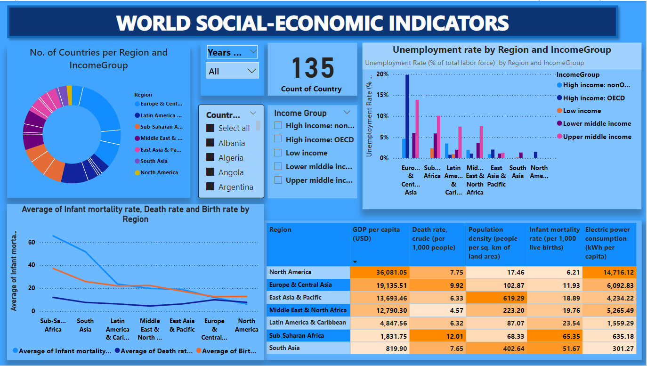
Power Bi world social-economic indicators dashboard

Slide 26
An analysis of the different elements of the dashboard
1. No. of Countries per Region and IncomeGroup
Visualization: Donut chart showing the distribution of countries by region and income group.
Insight: This visualization helps to understand the geographical and economic distribution of countries. For instance, it can reveal how many countries fall into each income category within a specific region, aiding in targeted economic analysis or policy-making.
Business Decision: Businesses can use this information to identify potential markets for expansion based on income levels and regional distribution. For instance, focusing on high-income regions for premium products or low-income regions for affordable solutions.

Slide 27
2. Unemployment Rate by Region and IncomeGroup
Visualization: Bar chart showing unemployment rates by region and income group.
Insight: The chart shows that Europe & Central Asia have the highest unemployment rates, followed by regions like Sub-Saharan Africa and Latin America & Caribbean. This suggests that economic challenges might be more pronounced in these areas.
Business Decision: High unemployment rates in Europe & Central Asia indicate economic instability which may affect market potential but also present opportunities for workforce availability. Businesses might consider investing in these regions to create job opportunities or tap into the available labor force. Alternatively, businesses should be cautious of economic instability in these areas when planning market entry.

Slide 28
3. Average of Infant Mortality Rate, Death Rate, and Birth Rate by Region
Visualization: Line chart showing trends in infant mortality, death, and birth rates across regions.
Insight: This visualization provides insight into the health and demographic trends in different regions. For instance, Sub-Saharan Africa shows higher infant mortality and death rates compared to other regions.
Business Decision: Health-focused businesses and NGOs can use this data to identify regions in need of medical supplies, healthcare services, and support programs. Companies in the health sector might find opportunities for investment and expansion in regions with high infant mortality and death rates.

Slide 29
4. Socio-Economic Indicators Heatmap
Visualization: Heatmap displaying various socio-economic indicators such as GDP per capita, death rate, population density, infant mortality rate, and electric power consumption by region.
Insight: This heatmap allows for a comparative analysis of socio-economic conditions across regions. The intensity of the colors helps to quickly identify regions with extreme values. For example, North America has the highest GDP per capita and electric power consumption, while Sub-Saharan Africa has the lowest GDP per capita and highest infant mortality rate.
Business Decision: This data can inform various business strategies:
Market Potential: High GDP per capita regions (e.g., North America) can be targeted for high-end products and services.
Infrastructure Development: Regions with low electric power consumption (e.g., Sub-Saharan Africa) may offer opportunities for investment in infrastructure and renewable energy projects.
Healthcare Initiatives: Regions with high infant mortality rates (e.g., Sub-Saharan Africa) could benefit from healthcare investments and philanthropic activities.

Slide 30
Recommendations:
Targeted Market Expansion: Businesses should consider expanding into high-income regions for premium products and into low-income regions with affordable offerings tailored to local needs.
Investment in Workforce Development: Companies can leverage high unemployment rates in regions like Sub-Saharan Africa to establish operations, provided the economic and political conditions are stable.
Healthcare and Social Initiatives: Invest in regions with poor health indicators to improve community well-being and create a positive brand image. This can also open up new markets for healthcare products and services.
Infrastructure Projects: Consider opportunities in regions with low electric power consumption for infrastructure and energy projects, potentially in partnership with local governments or international organizations.
By analyzing these socio-economic indicators, businesses can make informed decisions about market entry, product development, and corporate social responsibility initiatives. The heatmap's visual intensity provides a quick reference to identify areas needing attention or presenting opportunities.

Slide 31
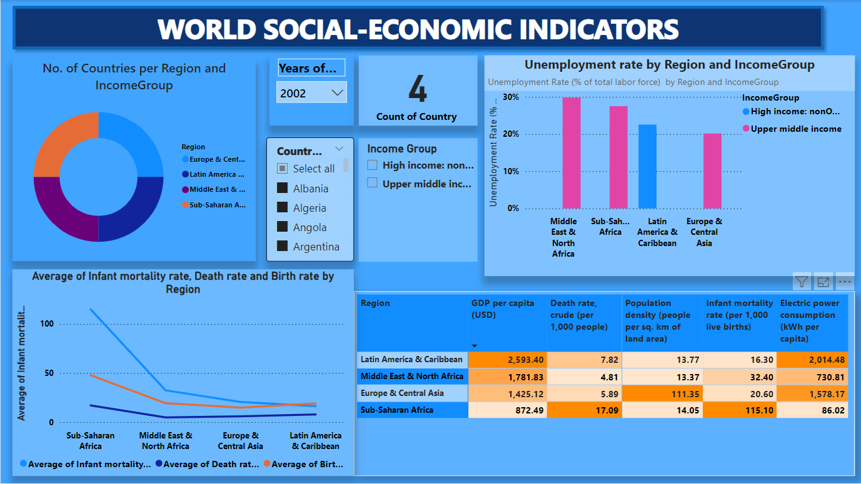
Slicers in dashboard
Dashboard showing statistics for the year 2002 for Albania, Algeria, Angola and Argentina. It shows unemployment rate in 2002 for those countries and income groups they belong to.

Slide 32
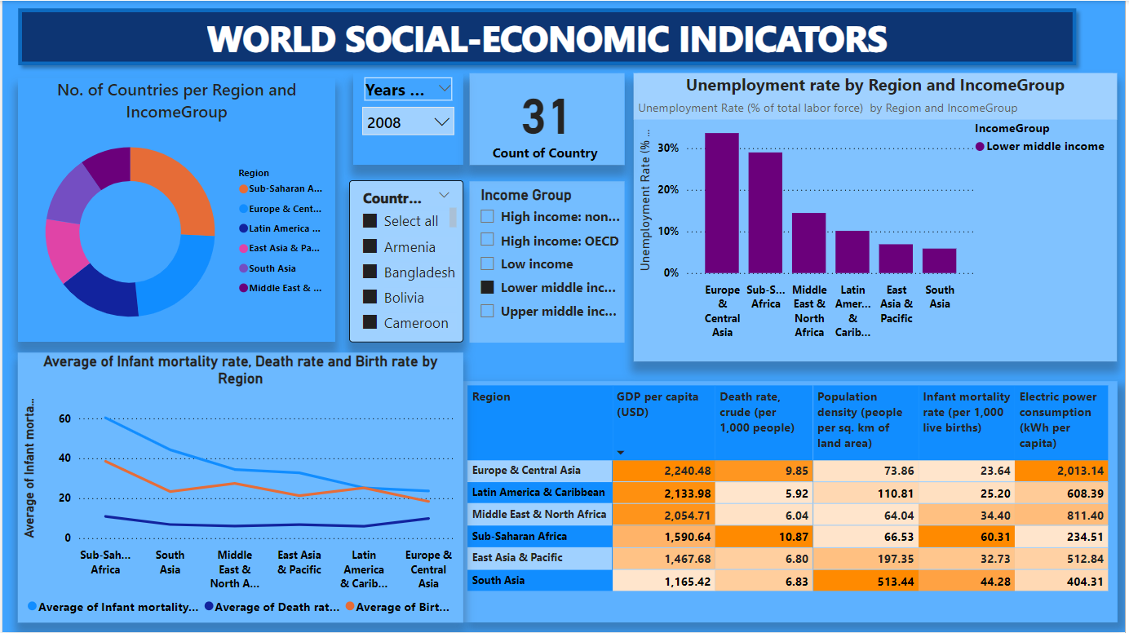
Card Counter
The above snapshot is showing that in 2008 we had 31 countries belonging to the lower middle income group and the highest unemployment rates in that year was in countries from Europe and Central Asia followed by Sub-Saharan Africa.

